Slide 1
Nitric Oxide and Heart Health
Sandy Seeman, ND
Dragonfly Naturopathic Health Care

Slide 2
Why Increase Nitric Oxide?
Dilates blood vessels, lowers blood pressure about 10 points
Increases blood flow
Decreases platelet aggregation
Increases oxygen delivery to tissues – wound healing
Improves exercise tolerance
Insulin resistance
Mitochondrial function
Improves cognitive function

Slide 3
Food Content of Nitrates
Dietary nitrates along with vitamins and minerals are better than supplementing alone
Vascular walls build a tolerance to NO, so only treat for 12 hours/d
Food and supplement sources of nitrates and NO production
Beets and pomegranates – powders and juices
Leafy greens like spinach, kale, chard, cabbage, celery
L-arginine – nuts
L-citrulline – watermelon
Panax ginseng, Maca – hormone balancing benefits and NO production

Slide 4
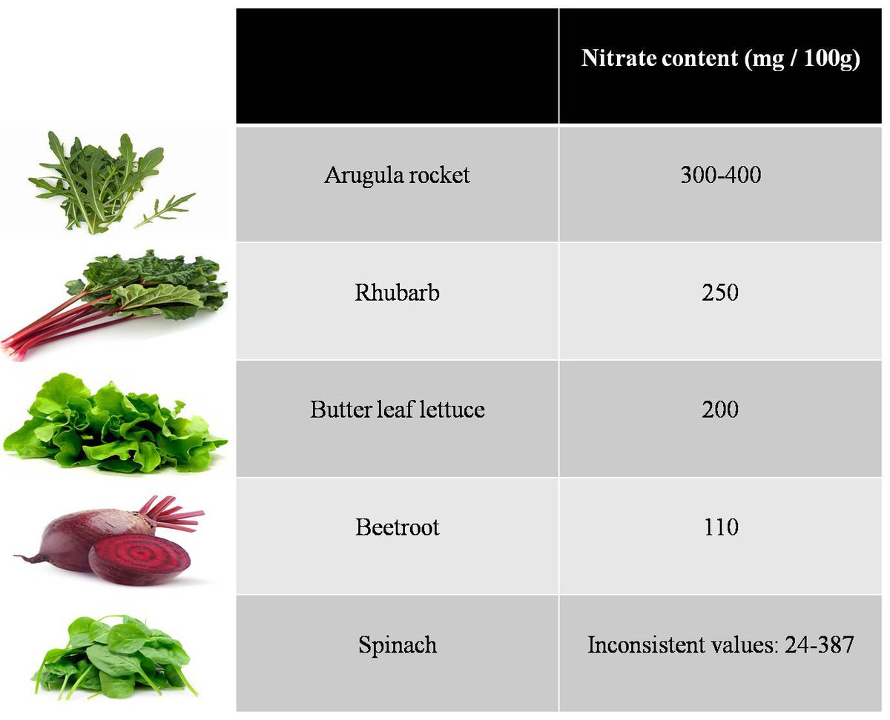
Food Amounts of Nitrates
Nitrate supplements cost around $2-4 per day
100g is about 2 large handfuls
Nitrate content depends on soil, freshness of food, and time of year harvested
Digestive bacteria make a difference in nitrate content, and the more of these foods you eat the more of that bacteria you have
Class | Group A | Group B
Class 1 | 82 | 95
Class 2 | 76 | 88
Class 3 | 84 | 90

Slide 5
Exercise Improves NO, Nitrates benefit Exercise
90 seconds is all it takes to exhaust the NO in big muscle groups
Can be used alone as a quick lift to mood, energy, circulation
Incorporated as a warmup or cool down for a workout
Intended to be repeated multiple times per day
Testing is the best way to know your levels
Step 1
Squats
Arms in Front X 10
Step 2 and 3
Arms Alternate in Front X 10
Arms Jumping Jacks X 10
Step 4
Arms Overhead X 10
Repeat Each 3X

Slide 6
Sandy Seeman, ND Naturopathic consultant http://www.dragonflyhealthcare.com

